Slide 1

GIT

Slide 2




Dilum Navanjana
Senior Software Engineer
99x Technology
DilumN@99x.lk
dilumn_
dilumn

Slide 3

What is GIT

Slide 4

Why we use GIT

Slide 5
Remote
Local

Slide 6
Committed
Local
Staged
Changes

Slide 7
Remote
Committed
Local
Staged
Changes

Slide 8
Committed
git commit
Staged
git add
Changes

Slide 9
Remote
git push
git pull
Local

Slide 10
Remote
git clone
Local

Slide 11
Remote
Local
clone
add
commit
push
pull

Slide 12
Scenario 01
Take a repository to the local for the first time

Slide 13

git clone https://github.com/dilumn/git-plan.git
Scan me

Slide 14
Scenario 02
Take a repository to the local for the first time
Make some changes
Push those changes to remote

Slide 15
git clone https://github.com/dilumn/git-plan.git
git add .
git commit -m “commit message”
git push origin master

Slide 16
Scenario 03
Push your existing project to Github

Slide 17
git init
git remote add origin https://github.com/dilumn/git-plan.git
git add .
git commit -m “commit message”
git push origin master

Slide 18
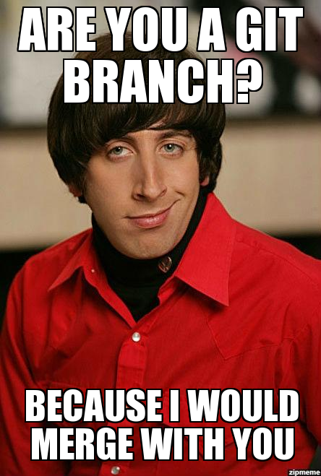
git branching

Slide 19


Slide 20
master

Slide 21
git checkout -b testing
master
testing
git checkout master

Slide 22
git checkout -b testing
master
git checkout -b login-test
testing
login-test

Slide 23
git checkout -b testing
git checkout -b login-test
master
testing
login-test

Slide 24

git merge

Slide 25
git merge testing
master
testing

Slide 26
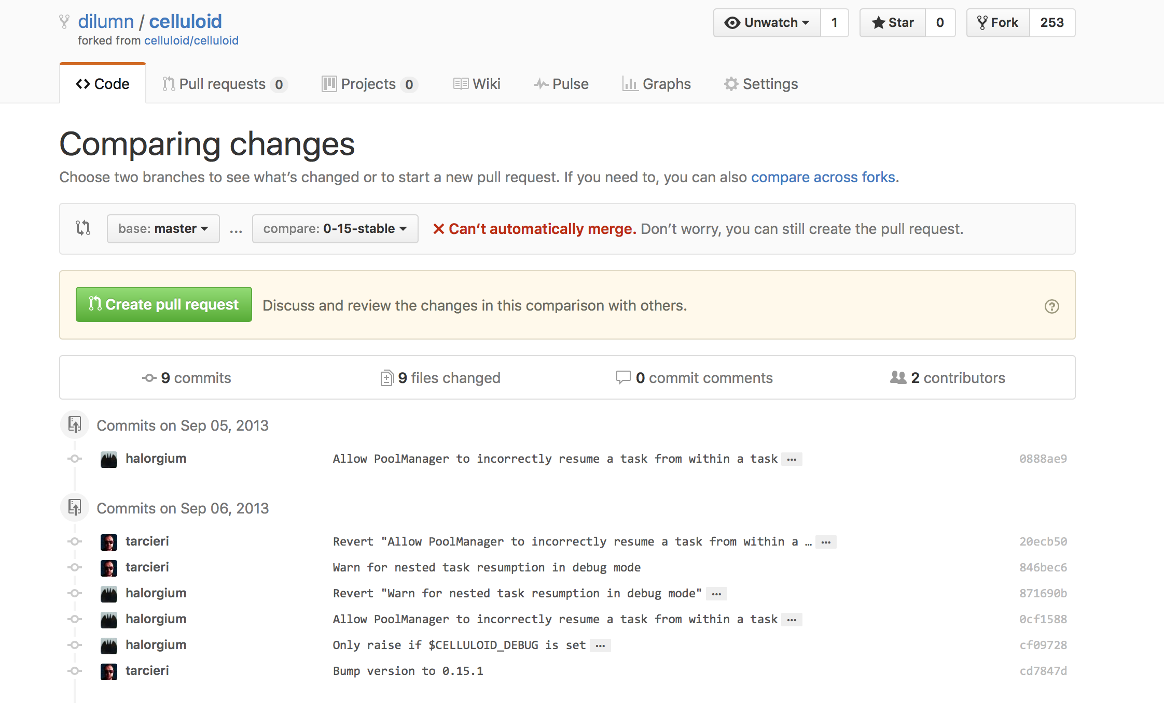
merge from a pull request

Slide 27
git merge testing
master
testing
merge conflicts

Slide 28
Demo

Slide 29
Scenario 04
Create a new branch “branch1” from master
Do some changes to a file. Commit & push them
Go to master branch, change the same file, commit & push the changes
Create a pull request from “branch1” to master
merge “branch1” to master

Slide 30
git checkout -b branch1
git add .
git commit -m “changes from branch1”
git push origin branch1
git checkout master
git add .
git commit -m “changes from master”
git push origin master
git merge branch1
git add .
git commit -m “merge conflict fixes”
git push origin master

Slide 31

git rebase

Slide 32
master
testing
git rebase master

Slide 33
master
testing

Slide 34
git rebase & merge
master
testing

Slide 35
Demo

Slide 36
Scenario 05
Create a new branch “branch2” from master
Do some changes to a file. Commit & push them
Go to master branch, change the same file, commit & push the changes
Rebase “branch2” from master
merge “branch2” to master

Slide 37
git checkout -b branch2
git add .
git commit -m “changes from branch2”
git push origin branch2
git checkout master
git add .
git commit -m “changes from master”
git push origin master
git checkout branch2
git rebase master
git add .
git rebase --continue
git push origin branch2 --force

Slide 38

git cherry-pick

Slide 39
master
testing
git cherry-pick HASHCODE
login-test

Slide 40
master
testing
login-test

Slide 41
Scenario 06
Cherry pick branch1 5kw32 commit to branch2

Slide 42
git checkout branch2
git cherry-pick 5kw32

Slide 43

git stash

Slide 44
Demo

Slide 45

git reset

Slide 46
git reset --hard HEAD~
master

Slide 47
master

Slide 48
Committed
git commit
Staged
git add
Changes

Slide 49
Committed
git reset --soft HEAD~
Staged
git reset
Changes
git checkout FILE_NAME

Slide 50
Scenario 07
Do some changes and commit them
Discard that last commit
Commit some changes again
Take them back to staged state
Take them to changes state
Discard those changed files

Slide 51
git add .
git commit -m “commit message”
git reset --hard HEAD~
git add .
git commit -m “second commit”
git reset --soft HEAD~
git reset
git checkout FILE_NAMES

Slide 52

fork repository

Slide 53


dilumn
dilumn_

Slide 54

https://github.com/dilumn/git-presentation
Scan me

Slide 55


Slide 56


